Slide 1
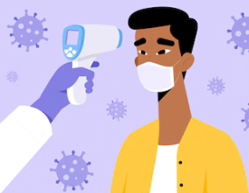
MARCH 2020:
3/19 – Thermal screening on Penn employees upon entry to Penn facilities:
<100F = cleared to work
> 100F = more comprehensive assessment required
APRIL 2020:
4/1– Oral temperature screening for patients in the Abramson Cancer Center (>99F = requires further assessment)
End of April – Thermal temperature scanning at designated patient entry points (>100F = further assessment required) for all Penn Medicine Facilities
MAY 2020:
Lowered temperature threshold for all Penn employees, patients, and support persons
(>100F to >99F)
CURRENT:
Penn Employees complete: “PennOpen Pass”: daily symptom checker
Patients/Visitors: thermal scanning upon entry to Penn facilities continues
COVID 19 – Pandemic:
Evolution of Temperature Screening
Notes:
Travel screen on all patients: march 2020
Googles/Eye Protection: 4/20/2020

